Slide 1

Place Sharing Network
Supervisor: Mr. Huỳnh Anh Dũng
Students:
Võ Thanh Quảng
Lê Minh Quang
Trương Quang Dũng
Nguyễn Minh Quốc
Nguyễn Minh Vượng

Slide 2
Contents
1. Introduction
2. Project Management Plan
3. Requirement Specifications
4. Design Description
5. Implementation
6. Test Documentation
7. Summary
8. Demo & Q&A

Slide 3
Part 1: Introduction
The People
Background
Literature Review
Our Proposal
Products

Slide 4






The people
Mr. Huỳnh Anh Dũng
Võ Thanh Quảng
Nguyễn Minh Vượng
- Instructor
- Developer
- Tester
- Developer
- Tester
- Project Manager
- Designer
Nguyễn Minh Quốc
- Developer
- Tester
Lê Minh Quang
- Configuration Manager
Trương Quang Dũng
- Developer
- Tester
- Developer
- Tester
- Quality Assurance
- Test Lead

Slide 5
Background
1
20% search queries on the Internet: finding places
Results are not determinable enough
3
Make users confused
4
2
End up going to wrong places!

Slide 6




Literature review

Slide 7

Literature review - Google Places
1
Focuses on business owners
2
Not fully supported in Vietnam
Many Vietnamese only know Google Search and Gmail!
3
Notes:
Focuses on business owners
Not fully supported in Vietnam
And the fact that many Vietnamese don’t know other (hundreds) products of Google other than Google Search and Gmail

Slide 8
Literature review - Facebook Places
See where your friends are and share your physical location
1
2
Location-based social network
3
Facebook is banned in Vietnam ☹
Notes:
A Facebook mobile application that allows you to see where your friends are and share your physical location
It’s a location-based social network
And… Facebook is banned in Vietnam

Slide 9


Literature review - Thodia.vn
A place sharing network of Vietnam
Mainly in HCM city
Not much information
Not many rating factors
Notes:
A place sharing network of Vietnam
Mainly in HCM city
Not much information
Not many rating factors

Slide 10
Literature review - Infomap.vn
Another place sharing network of Vietnam
No sorting feature when searching
No rating
Too many places with low quality
Notes:
Another place sharing network of Vietnam
No sorting feature when searching
No rating
Too many places with low quality

Slide 11
Our proposals
Vietnamese users
Vietnamese address
Contribution and opinion from all users
Give the best information they need
Vietnamese
Information
Network
User Friendly
More interesting
More spam-free
Make the system user-friendly
Have best performance
Notes:
Specialized for Vietnamese users and Vietnamese addresses
With the contribution and opinion from all users, the places are correctly rated and will give the users the best information they need
Utilize social network model to make the process of contributing information more interesting and more spam-free
Utilized newest technologies to make the system user-friendly and have best performance

Slide 12

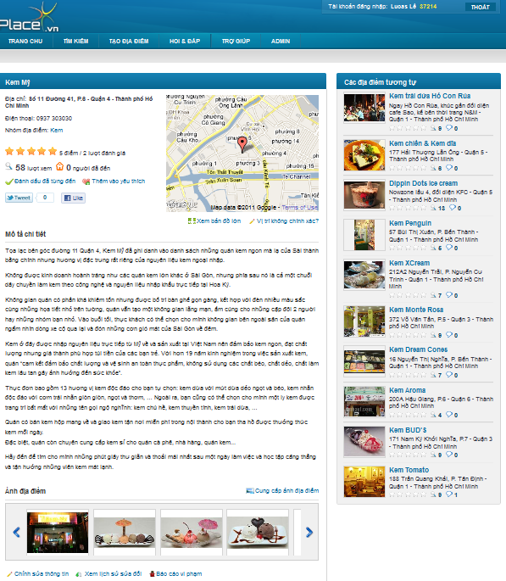
Products
Mobile apps
(out of scope)
Website

Slide 13
Part 2: Software Project Management Plan
The proposed system
Development Environment
Process
Project organization
Project Planning

Slide 14

The proposed system – Front-end
Front-end:
Anyone : visit, search for places of any kinds
Authenticated users:
Post places
Evaluate places
Rating
Review
Comments
Visiting…
Edit place’s information
Ask for particular purpose (Q&A)
Integrate well with some other popular networks

Slide 15
The proposed system – Back-end
Manage Users
Manage Spam Report
Manage Places
Back-end
Manage Address Parts
Manage Categories
Manage Contacts
Manage the most important activities

Slide 16

The proposed system - Commerce
Commercial ability:
Place owners
Their places to be the first item in search result or home page
Post special offers on their places’ page
Service for verifying places
Ad banners on the site
Selling mobile applications

Slide 17


Dev Environment - Hardware
Development Hardware
3 Gb of RAM
100Gb of hard disk
Core 2 Duo 2.0 Ghz
Server Hardware
4 Gb of RAM
100Gb of hard disk
Core 2 Duo 2.0 Ghz

Slide 18







Dev Environment - Software

Slide 19
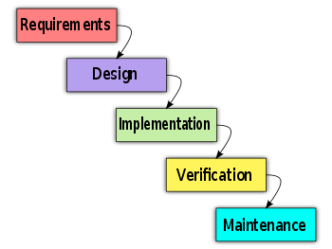
Process
Follow Waterfall model

Slide 20
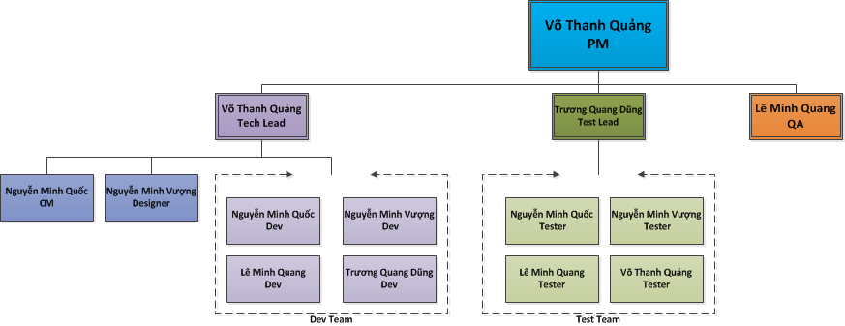
Project Organization

Slide 21

Project Planning
Follow Capstone Project requirements
Buffer: 20% (about 3 weeks)
“Consumed” buffer: 1.5 weeks
Submit all reports on time

Slide 22
Part 3: System Requirement Specifications
User Requirements
System Requirements
Non-functional requirements*

Slide 23

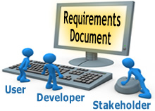
User requirements
User
Administration
Ranking
Comments / Answer
Places
Search

Slide 24
User Requirements – Users
Create a new account & login to the system
Change password & information
Search for places
Create & edit places
View & compare history of places
Write, delete, vote & report comments
View, upload images, rate & share .. places

Slide 25

User Requirements – Admin
Categories
Users
Advertises (out of scope)
Spam reports
Places
Contacts
Address Parts
Use all functions in the system

Slide 26
User Requirements – Ranking
Use User Point
Starter point : 10
Create a place: +20
Spam: - 25
Can’t earn >100 points a day
Other activities: future
Normal user: < 1000 Points
Trusted user: >= 1000 Points

Slide 27

User Requirements – Ranking
Only trusted users:
Edit place without pending
Approve revision
Upload images without pending
List :
20 newest places
10 hottest places
20 newest question
10 most contributors

Slide 28

User Requirements - Comment / Answer
Any authenticated users can comment/answer
Can be voted, reported
Highlight 2 most voted

Slide 29
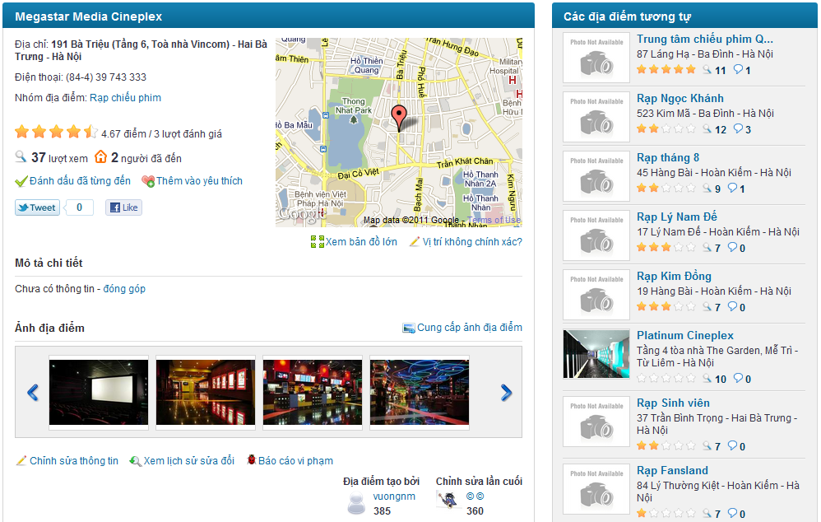
User Requirements - Places
Name
Detail Address
District
City/Province
Description
Phone number
Category
Rating
Visited number
View number
Place Images
Suggestion List: 15 hottest and newest places in the same category and area

Slide 30
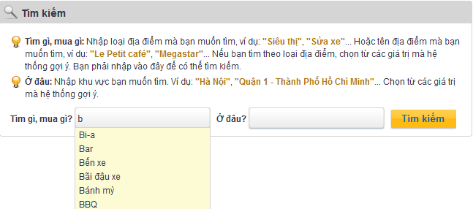
User Requirements - Search
Search
Search by category, place name, and area
Keyword suggestion

Slide 31
System requirements
Document requirements for each use case
Each includes:
Use case diagram
Actor
Summary
Goals
Triggers
Preconditions
Post conditions
Success scenarios
Alternative scenarios
Exceptions
Relationship
Business rules
Description
Screen
Data field definitions
Button definitions

Slide 32
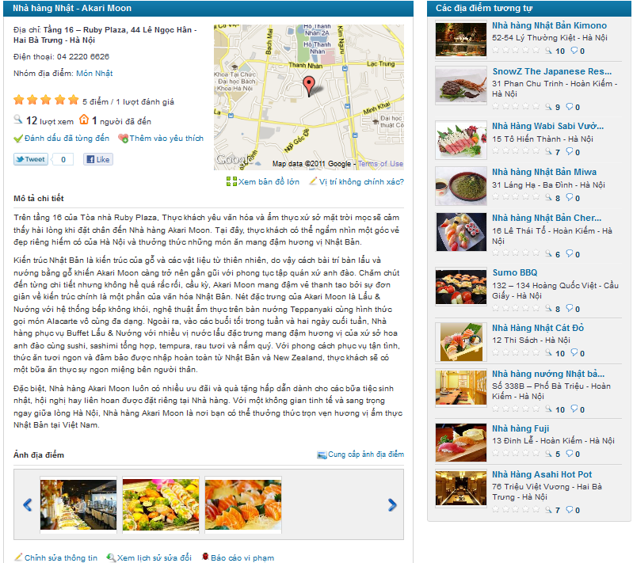
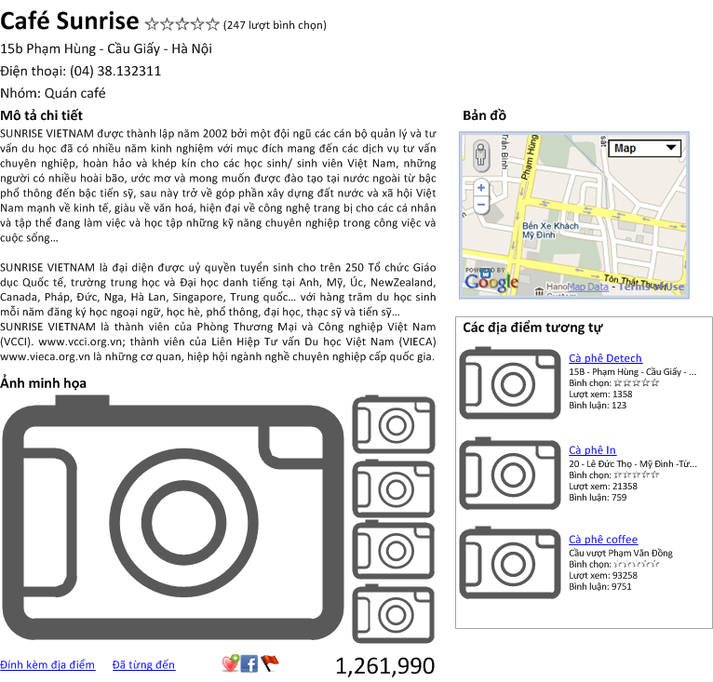
Screen: Before & After

Slide 33
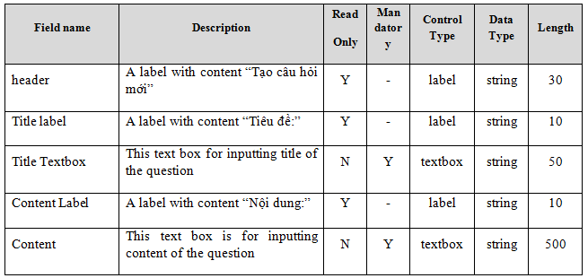
System requirements
Data Fields Definition:
Field name
Description
Read-only
Mandatory
Control type
Data type
Length

Slide 34
Non-functional requirements
Usability
Availability
Reliability
Security
Security
Performance
Maintainability

Slide 35
Usability
Front-end language: Vietnamese
UI: elegant, simple, out-standing
Searching tool: easy to use
Provide a help page to support novice users
Easy to deploy

Slide 36
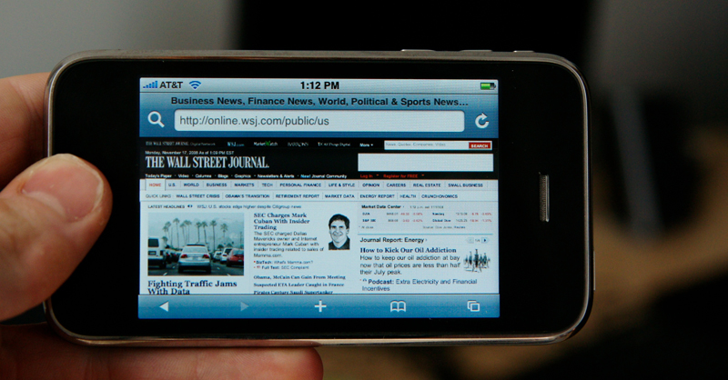

Usability (future)
Mobile views
Support disabled people

Slide 37


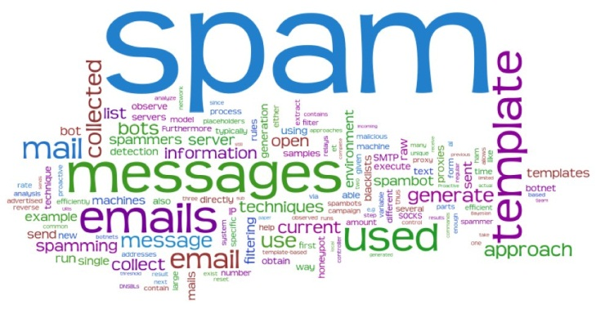
Reliability
Initial data: collected carefully and correctly
Database and files: backed up regularly
Spam filter
Rating system: must be reliable

Slide 38

Reliability (don’t believe these ☺)
Rate of fault occurrence (ROFO): 0.005
Mean Time Between Failures (MTBF): 1 month
Mean Time To Repair (MTTR): 1 day
Maximum Bugs or Defect Rate: 5 bugs / KLOC

Slide 39
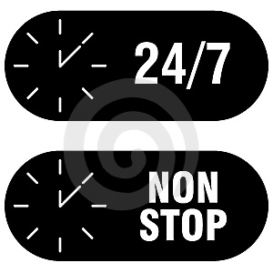
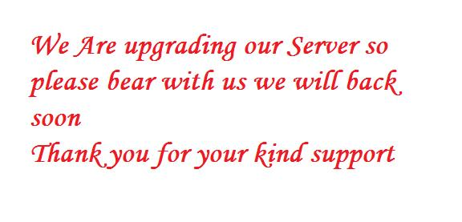
Availability
Run 24/7
Can be turned off when upgrading

Slide 40

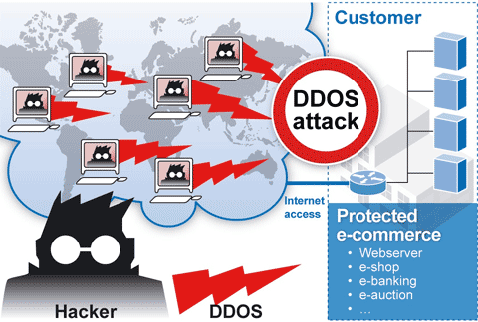
Security
Privacy: protect user information
User password must be invisible even to admin
Prevent: SQL injection, XSS, DDOS…

Slide 41

Maintainability
Follow coding standard and naming conventions
Loosely coupled design
Logging functionality
Feedback (contact@place.vn)

Slide 42
Performance
Load time: average 1.5 second
Comments, rating: no page reloading
Caching
Frequently accessed data
Reference data
Mail server: send emails within 1 minute
1000 online users at a moment
100.000 places, 10.000 users without affecting the loading speed

Slide 43
Part 4: Software Design Description
Architectural design
Detailed design
Database design

Slide 44
Architectural design
Overall design
Components
Patterns

Slide 45
Architecture - Overall Design

Slide 46
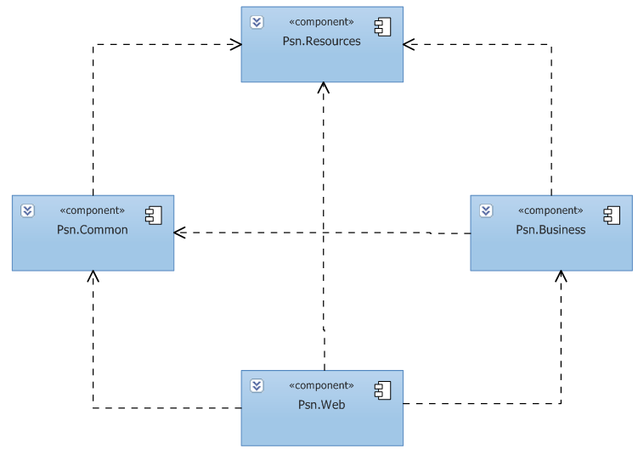
Architecture - Components

Slide 47
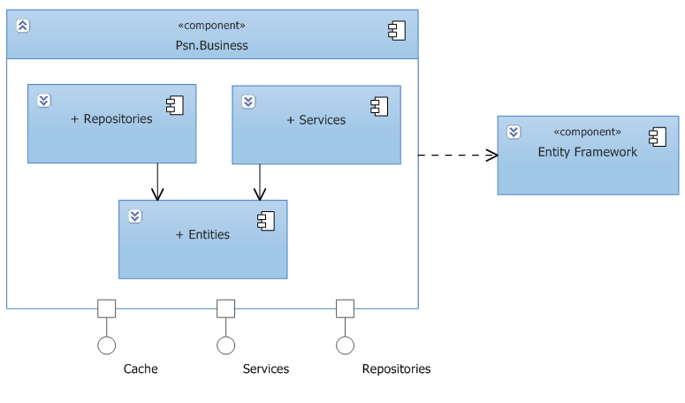
Architecture - Business component
Business Component

Slide 48
Architecture – Web component
Web Component

Slide 49
Architecture – Common component
Common Component

Slide 50
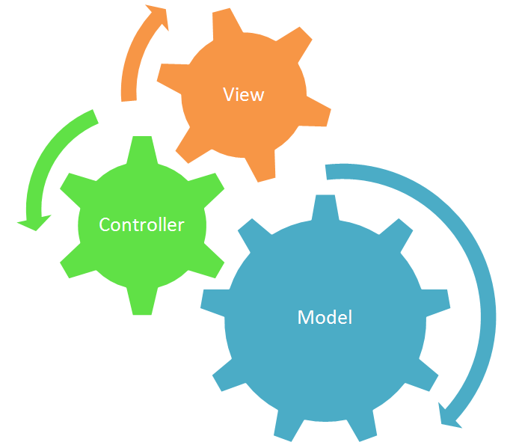
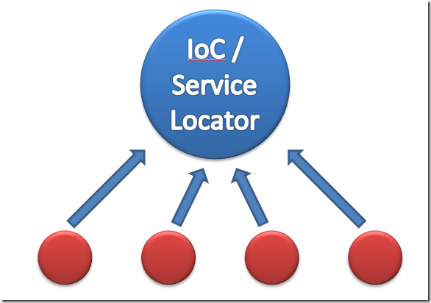
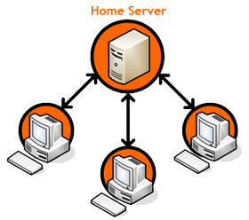
Architectural & design patterns
MVC
Client-Server
Dependency Injection
Service Locator
Repository
Singleton

Slide 51
Detailed design
Design for each use case
Class diagram
Class explanation
Sequence diagram

Slide 52
Class Diagram
Class diagram example

Slide 53
Class Diagram
Sequence diagram example

Slide 54
Database design
Business tables
Support tables: statistics, config…
Every table has a primary key named Id which is of type: INT NOT NULL IDENTITY(1, 1)
Max length and nullability strictly follow field definitions

Slide 55
Database design – ERD
Use Crow’s Foot notation
Notes:
Crow foot notation

Slide 56
Class Diagram
Database design – ERD

Slide 57
Database design - Tables

Slide 58
Class Diagram
Database design – Tables

Slide 59
Part 5: Implementation
Technologies
Tools
Coding convention
Code review
Unit test
Performance considerations
Security considerations

Slide 60




Technologies

Slide 61




Tools

Slide 62


Coding conventions
Follow general .NET conventions
Follow FxCop rules
Specific conventions for the project
Notes:
Coding conventions:
Follow general .NET coding conventions
e.g. Pascal Casing, Camel Casing…
Follow FxCop rules
e.g. avoid empty interface (FxCop Microsoft.Design CA1040)
Create specific conventions for the project
e.g. all strings must be trimmed before inserting to the database

Slide 63
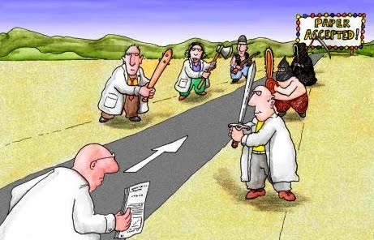
Code review
By technical lead
Peer review
Not done: run FxCop agains defined rules

Slide 64

Unit test
Mainly for data access layer and framework
Follow A/A/A pattern (Arrange/Act/Assert)
Not done: create NUnit report

Slide 65
Performance considerations
Caching in 3 layers: database, memory, output (HTML)
Use SQL Profiler to investigate all data access methods
Minimize requests to the server and database hit
Use JSON with AJAX
Compress and create thumbnail images
…

Slide 66
Security considerations
Client side and server side validation
No SQL injection
No XSS vulnerability
Encrypt sensitive data: password, cookies
Not done:
Use SSL
DDOS avoidance

Slide 67
Part 6: Software Test Documentation
Include:
Features to be tested
Features not to be tested
Test case
Check list

Slide 68
Test result
Number of test cases: 544
Number of passed cases: 544
Number of failed cases: 20 (fixed all)
Number of not tested cases: 0

Slide 69


Tested vs not tested
Unit test
Integration test
System test
Performance test
PEN test

Slide 70
Summary
Capstone Project: completed (in next 30’ ☺)
Product: deployed to http://www.place.vn/
Future:
Continue developing
Invest in this product (anyone interested?)

Slide 71
Demo
(try it yourselves: http://www.place.vn/)

Slide 72
Q&A

Slide 73
Thank You !

